Slide 1
Security information & event management with AlienVault OSSIM
NT534.O21.ANTT
Instructor: MSc. Nguyễn Duy
Our team:
21522010 - Trần Minh Duy
21520408 - Nguyễn Hoài Phương
21522627 - Phạm Ngọc Thiện

Slide 2
TABLE OF CONTENTS
01
02
03
04
05
Summary
Scope of work
Approaches
Architecture
Demo

Slide 3
01.
Summary

Slide 4
Summary
Complex network systems with a variety of information and security events need to be managed appropriately to easily detect, trace and recover when problems occur.
Deploying AlienVault OSSIM to a small business network system and testing features: Collect log, HIDS, Asset management, Scanning Vulnerable, Alarm management, Fast log generation

Slide 5
02.
Scope of work

Slide 6
SCOPE OF WORK
The system, which was deployed in VMware, collect log from OSes, Services, Security devices and be able to analyze and store.
Build the system includes 3 separate zones: LAN, DMZ and WAN. These 3 zones connect to each other through a Sophos UTM firewall.
LAN: Domain controller for authenticating and authorizing staffs
DMZ: Web server have been installed Apache, ModSecurity
Install OSSEC on all devices except WAN zone
AlienVault OSSIM solution :
Research and deploy AlienVault OSSIM architecture suitable for the system
Log collection: how to collect different type of logs, which agent suitable for each?
Storage and analysis in AlienVault
AlienVault function: Asset management, Alarm management, Event management, Vulnerability Assessment, Behavior Monitoring, Availability management …

Slide 7
ABOUT DETAIL SCOPE OF WORK
Assets Management
Vulnerability Assessment
Deploy vulnerabilities scan available in AlienVault for some assets in network
Analyze results
HIDS
Users download Rootkit
Fast log generation
Attacker attacks web server from Internet
Dictionary attack
DDos Attack
PortScan Attack
Users are not allowed to access a sensitive web

Slide 8
03.
Approaches

Slide 9
1. ASSETS MANAGERMENT & DISCOVERY
This capability allows users to discover and inventory all the assets in a network and to correlate asset information with threat and vulnerability data. This functionality uses active and passive network asset scanning
Links implementation
Asset management (youtube.com)
Running Vulnerability Scans from Assets - Level Blue
2. VULNERABILITY ASSESSMENT
Vulnerability assessment is another essential security capability that AV Appliance provides. With the asset-oriented security approach introduced in AV Appliance, you can schedule vulnerability scans directly from the assets
Links implementation
Vulnerability Scanning with AlienVault USM – YouTube
How to scan vulnerability with OSSIM? (youtube.com)
Running Vulnerability Scans from Assets - Level Blue

Slide 10
3. ALARM MANAGEMENT
AlienVault provides a consolidated view of alarms triggered within all connected deployments. An alarm consists of one or more events, based on the following:
- Based on correlation rules in alienvault that analyze events for behavioral patterns.
- Based on orchestration rules designed to raise an alarm for a particular type of event.
Links implementation
Alarms Management
Creating Rules from Alarms
4. HIDS DEPLOYMENT
Provide features: File integrity monitoring, Rootkit detection, Event log collection
Links implementation
HIDS (youtube.com)
Deploy LevelBlue HIDS Agents

Slide 11
5. BEHAVIOUR MONITORING
From a behavioral monitoring perspective, AlienVault correlates data from built-in netflow analysis and service availability monitoring technologies to pinpoint policy violations, insider threat risks, as well as malware infection and system compromise.
Links implementation
Behavioral Monitoring with AlienVault (youtube)
User Behavior Analytics
NetFlow Monitoring Configuration

Slide 12
5. LOGS COLLECTING
It collects, stores, and manages logs and event data from various devices and applications, helping organizations comply with regulatory requirements and aiding in forensic investigations.
1.Push: an agent be installed on the participating device to send (“push”) the latest batch of log records after a configurable time period (ex: windows connector)
Ex: Rsyslog
2. Pull: log into the device and “pull” the log records from the participating system’s own security logs (ex: syslog connector)
Ex: OSSEC

Slide 13
04.
Architecture

Slide 14
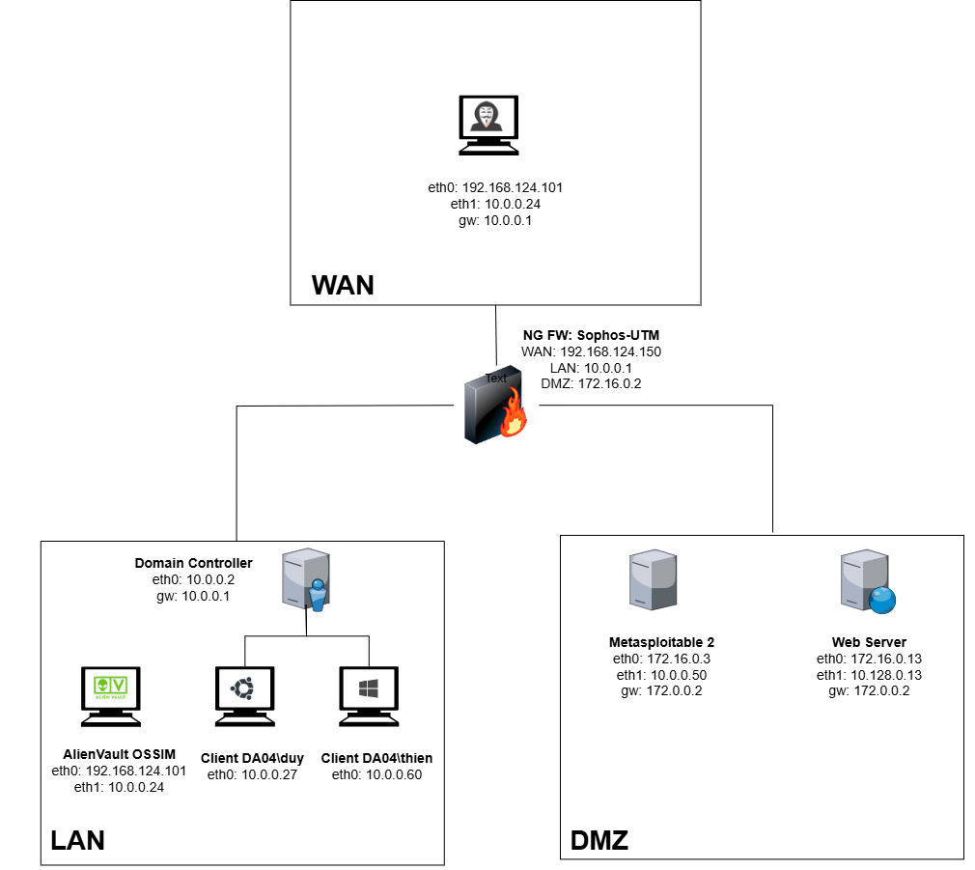
NETWORK TOPOLOGY
Simulate common network topologies in businesses
Basic and suitable for limited resource to deploy AlienVault features
Small size → AlienVault’s scalability and performance in an enterprise network is not demonstrated

Slide 15
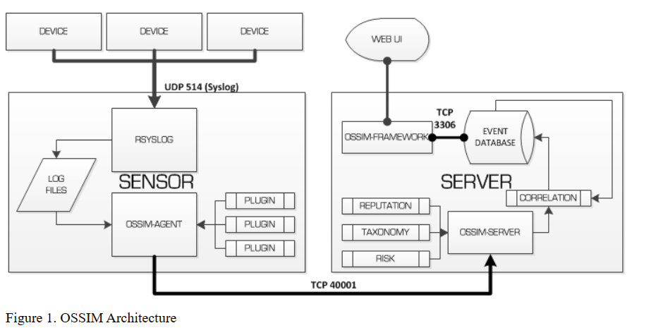
APPLICATION ARCHITECTURE
TCP/UDP port 514: receive logs + store locally
Log analysis + normalization -> Server
different plugins for each type of log
Connect & manage OSSIM components + security tools
Needs the least hardware resources (usually installed together with the Server component)
Stores events and system configuration data
Port 40001: Aggregation, Risk assessment, Correlation of events
2 types: Detectors & Monitors

Slide 16
1. SENSOR
The Sensor has two main components:
The rsyslog service(TCP/UDP port 514): receive logs + strore locally
The Ossim-agent: log analysis + normalization ->sends to Server component. (different plugins for each type of log)
Plugins are of two types:
Detectors (such as Snort, P0f, Arpwatch)
Monitors (like Ntop and Nagios).
2. SERVER
The Server (port 40001) : Aggregation, Risk assessment, Correlation of events.
The server also sends the information concerning the events to the Database for storage.
3. OSSIM
FRAMEWORK
The Framework connects and manages the OSSIM components and security tools included. Needs the least hardware resources (usually installed together with the Server component)
4. DATABASE
MySQL server instance:stores events and system configuration data.

Slide 17
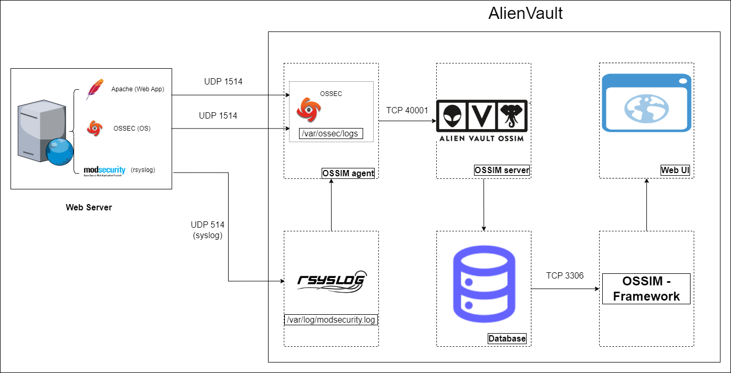
DATA ARCHITECT

Slide 18
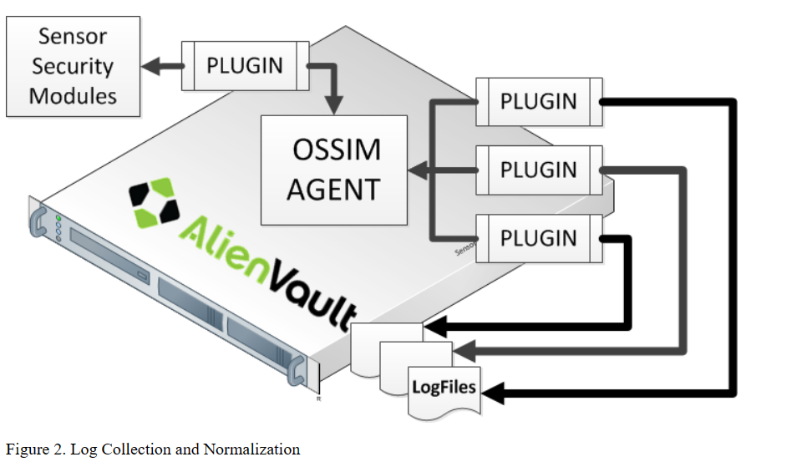
ALIENVAULT LOG COLLECTING
2 ways for collecting logs :
- Software agent collect + send logs to the Sensor component.
- Configure the devices it’s own to send the logs upon request of the appropriate Sensor plugins.
Once the Sensor records the logs:
OSSIM Agent analyzes and normalize logs → event → send to OSSIM server.

Slide 19
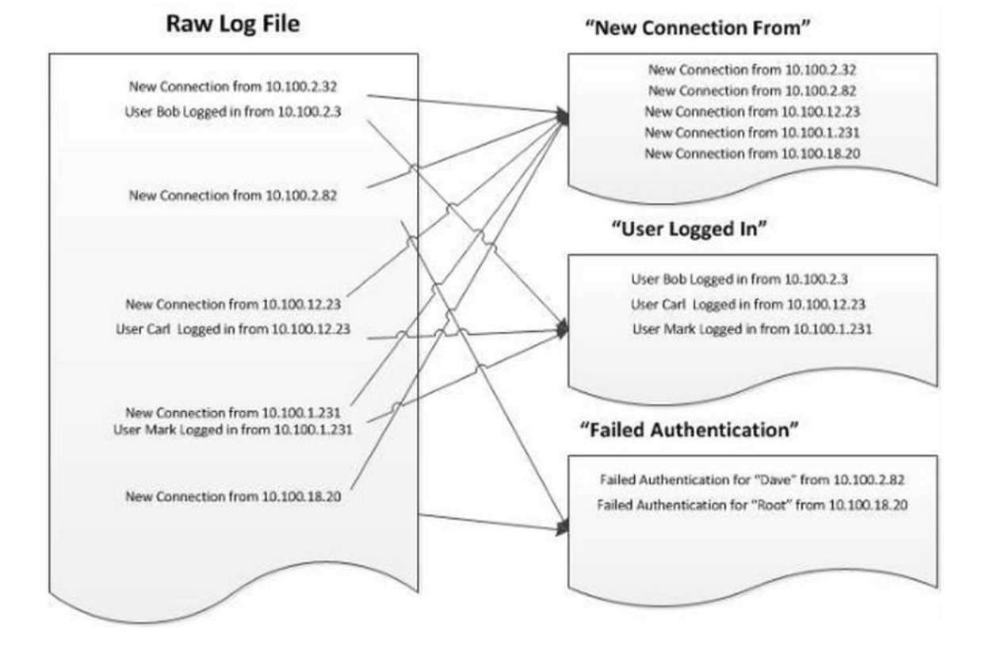
ALIENVAULT LOG COLLECTING

Slide 20
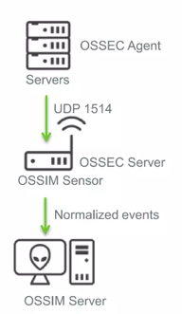
HOST IDS
OSSIM comes with OSSEC host-based IDS, which provides:
Log monitoring and collection
Rootkit detection
File integrity checking
Windows registry integrity checking
Active response
OSSEC uses authenticated server/agent architecture.

Slide 21
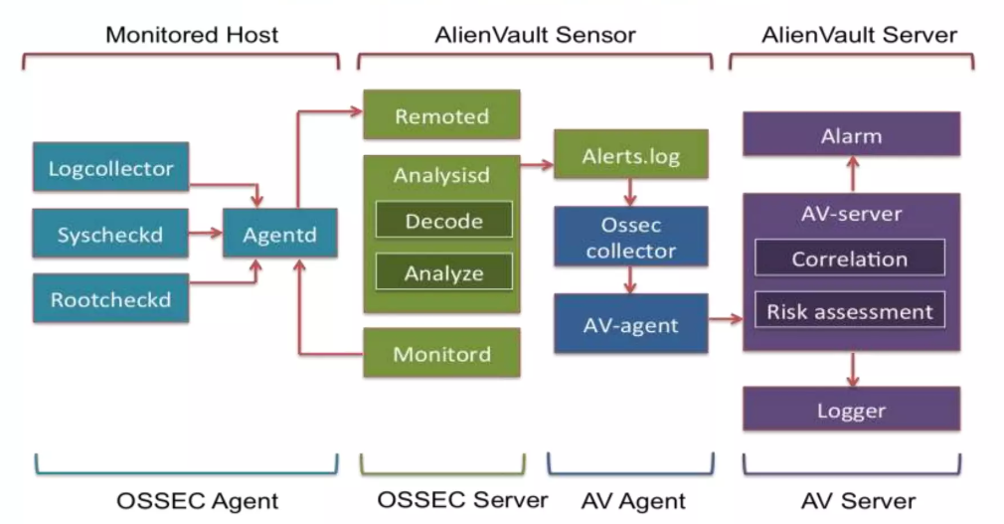
OSSEC IN AV ARCHITECTURE
Agent components:
Logcollectord: read logs (syslog, wmi, flat files)
Syscheckd: File integrity checking
Rootcheckd: Malware and rootkits detection
Agentd: Forwards data to the server
Server components:
Remoted: Receives data from agents
Analysisd: Processes data (main process)
Monitord: Monitor agents

Slide 22
VULNERABILITY ANALYSIS, INTRUSION DETECTION & NETWORK MONITORING:
OSSIM includes many valuable tools, which also are open-source, that are among the most known and used for intrusion detection, vulnerability analysis and network management and monitoring:
Asset discovery: Nmap, Prads
Behavioral monitoring: Netflow, Ntop, Nagios
Threat detection: Snort, Suricata, OSSEC
Vulnerability assessment: Openvas

Slide 23
05.
Demo
All demo: Click here!

Slide 24
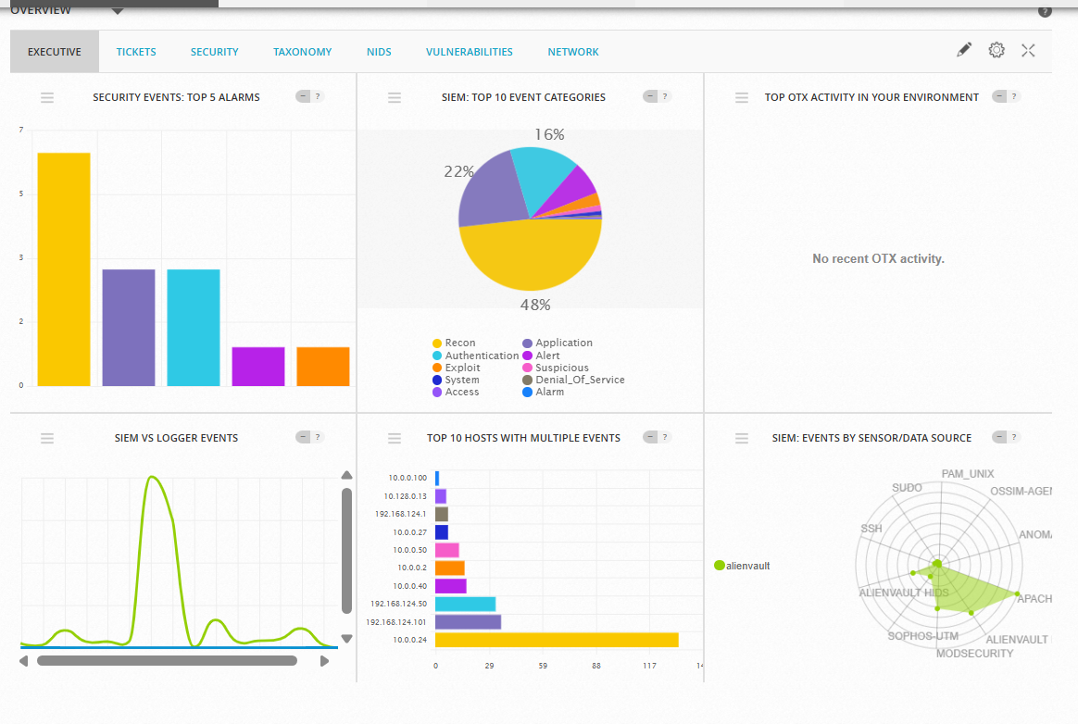
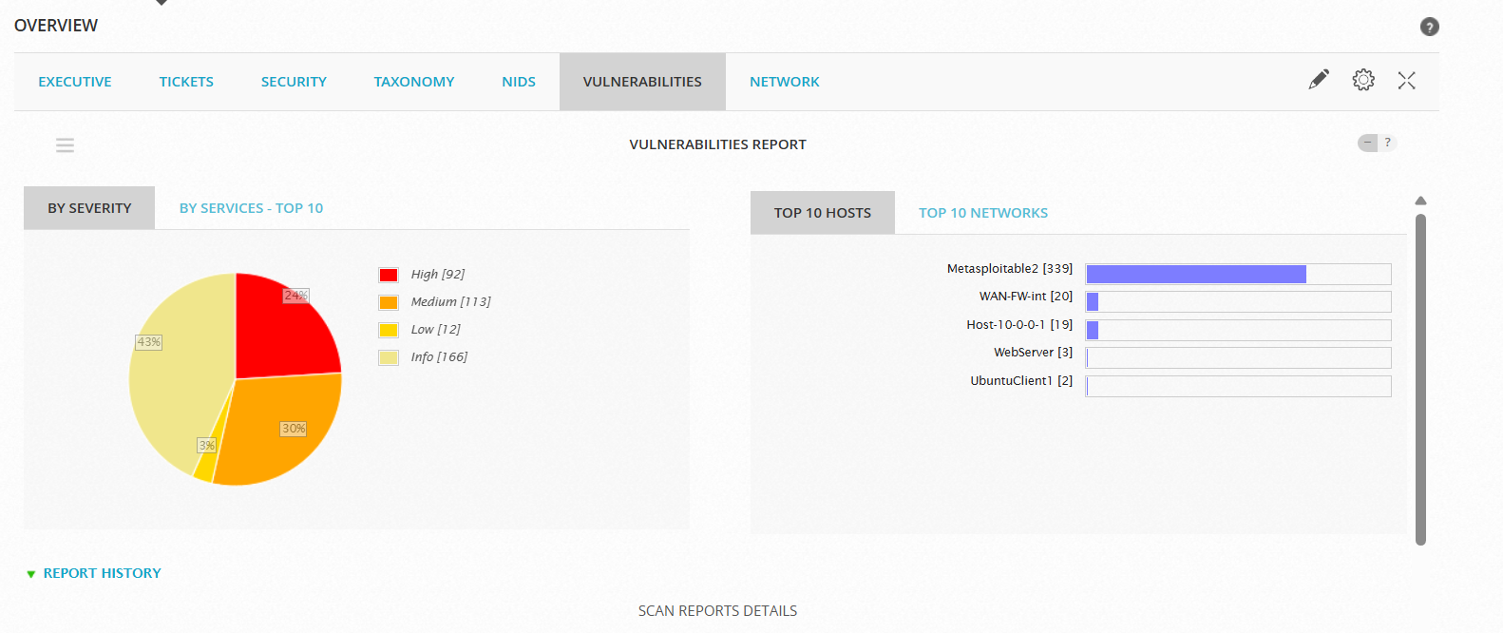
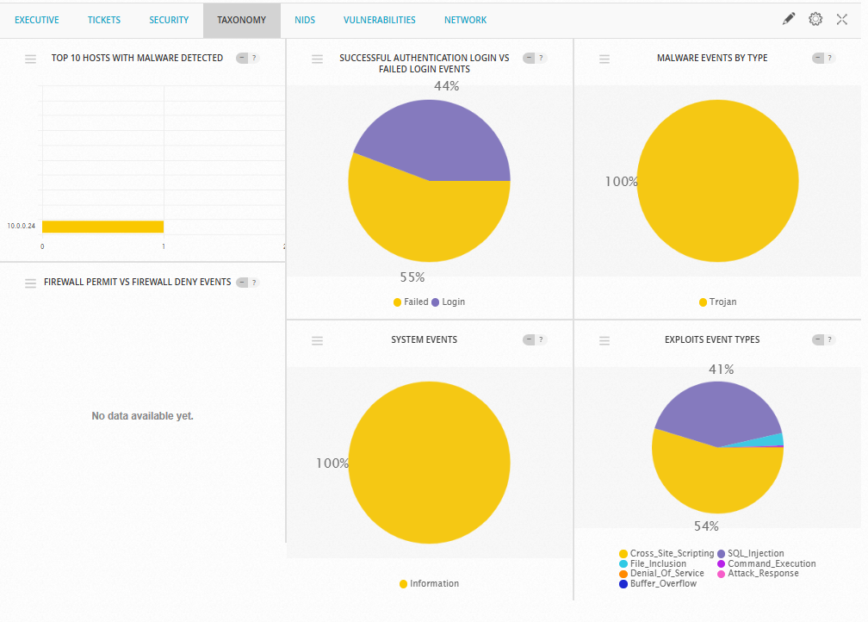
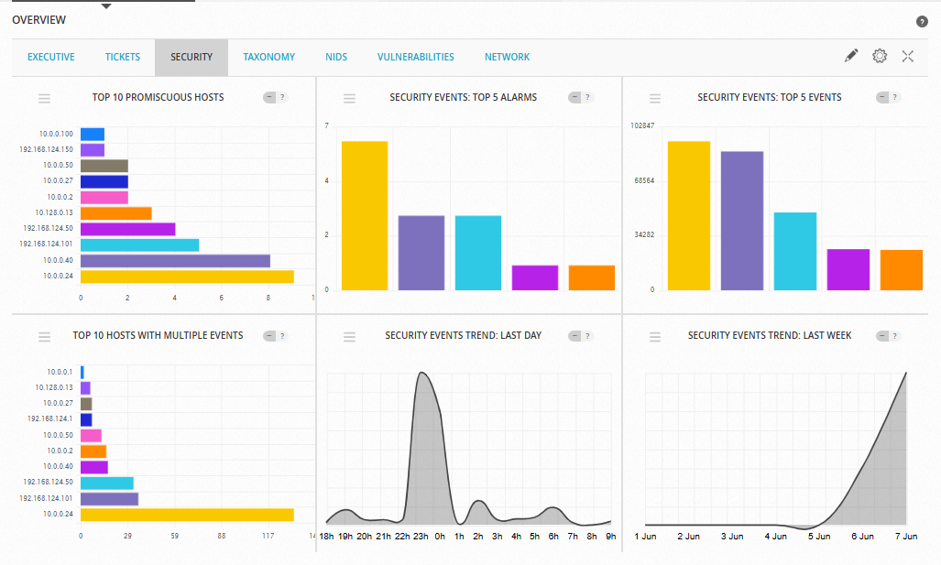
DASHBOARD

Slide 25
Fast Log Generation

Slide 26
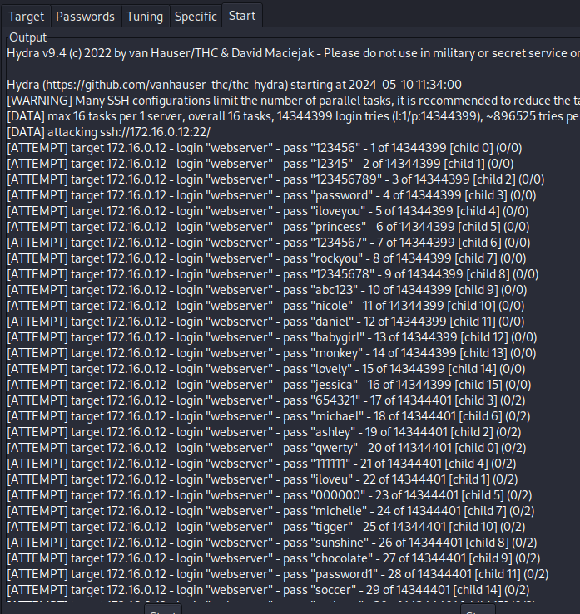
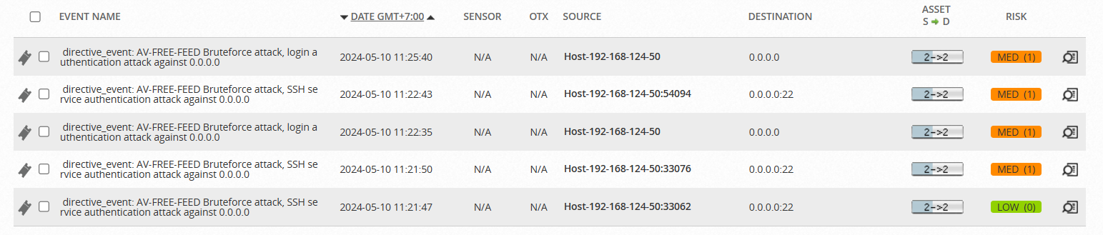
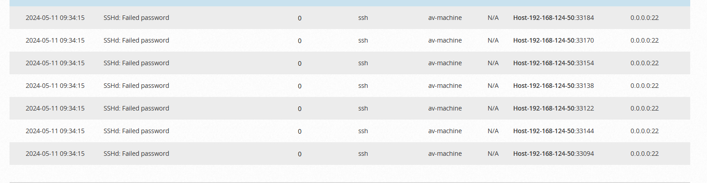
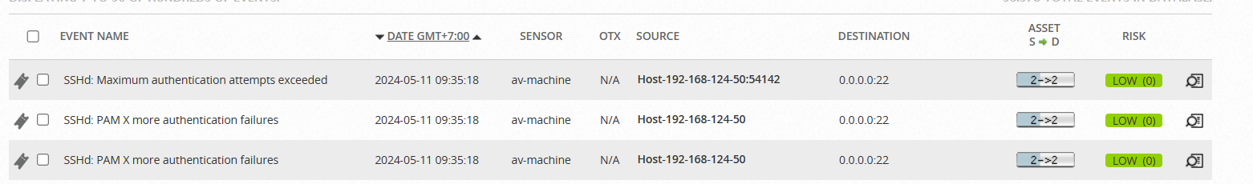
Scenario 1: Dictionary attack
Description: Using common word list to brute-force account
Tool: Hydra
Available Link demo: Click here!

Slide 27
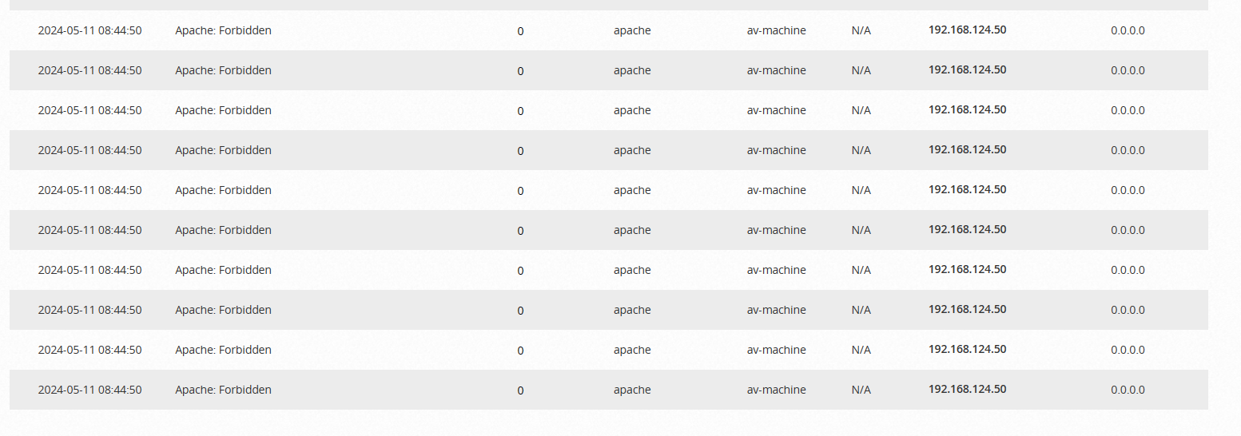
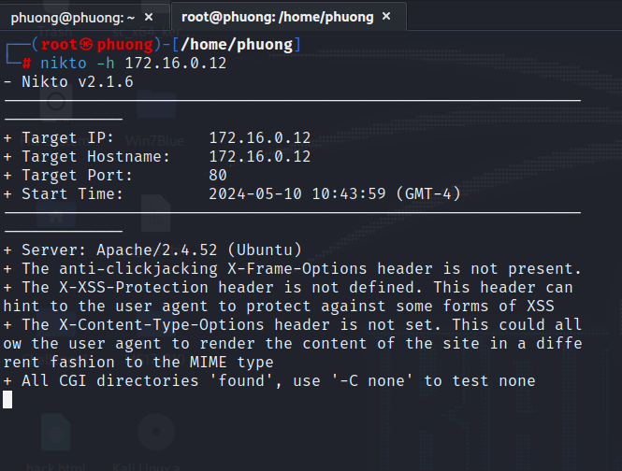
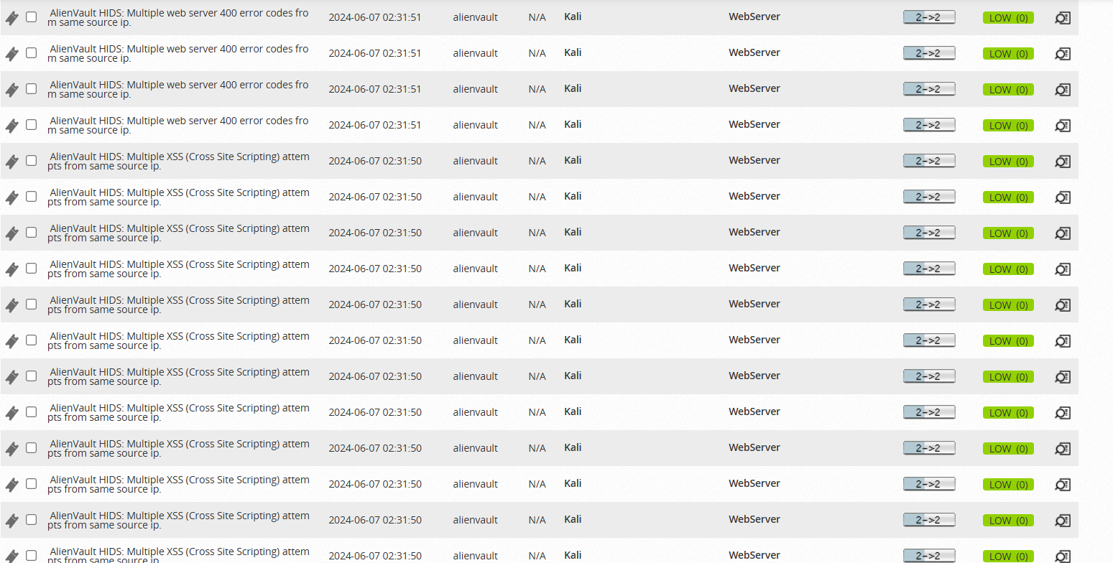
Scenario 2: WebServer Attack
Description: web server security assessment and vulnerability scan to detect potential vulnerabilities and security weaknesses in web servers
Tool: Nikto
Available Link demo: Click here!

Slide 28
Vulnerability Assessment
Available Link demo: Click here!
Description: Create new vulnerability scanning for the assets in system. Analyze result

Slide 29
HOST-IDS

Slide 30
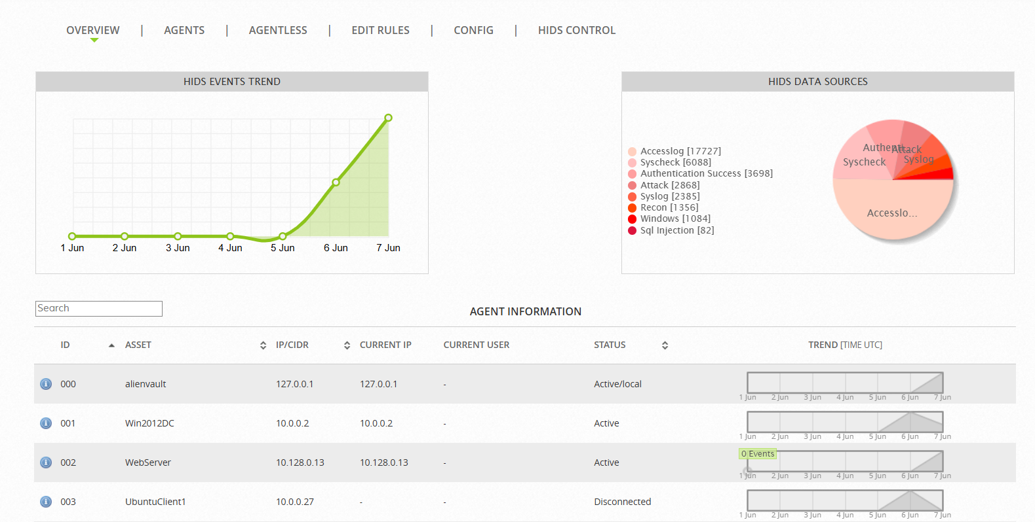
Fig: AlienVault HIDS deployment

Slide 31
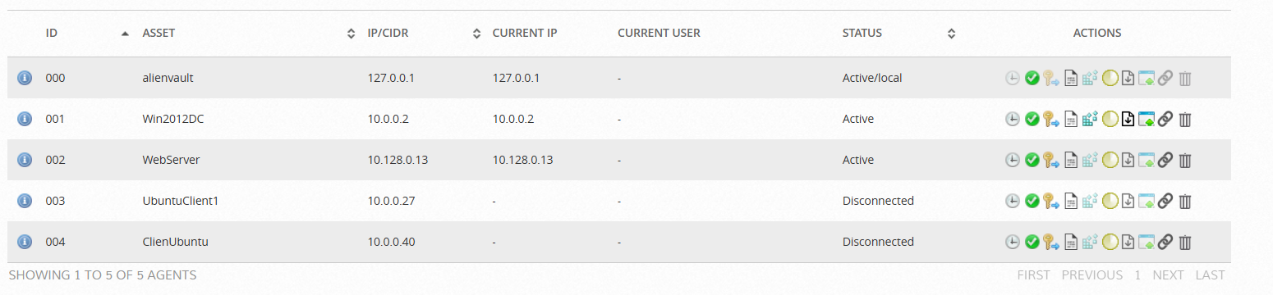
Modified Registry entries
Integrity/rookit checking
Etract Key
Modified File
Rootcheck

Slide 32
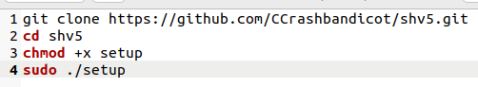
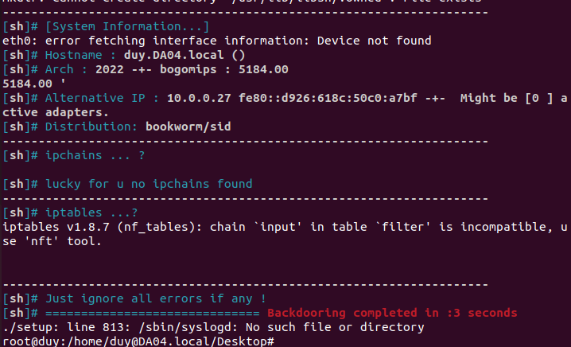
Scenario : Rootkit attack
Description: Suppose that 1 user in Local domain being attacked and occupied by hacker and hacker will install a rootkit (shv5 rootkit) and setup it in client machine
Create attack.sh
Run it

Slide 33
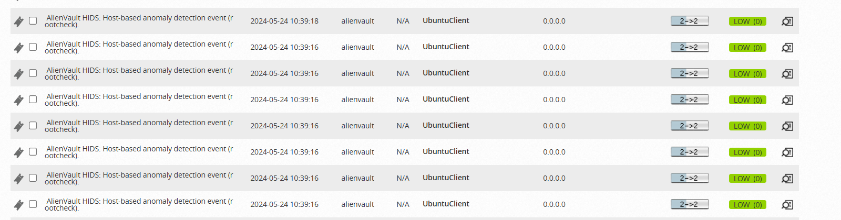
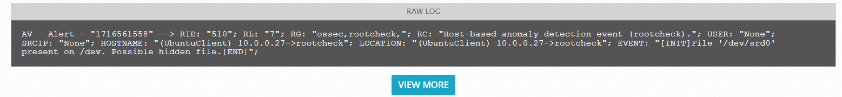
Scenario : Rootkit attack
Fig: AlienVault log event

Slide 34
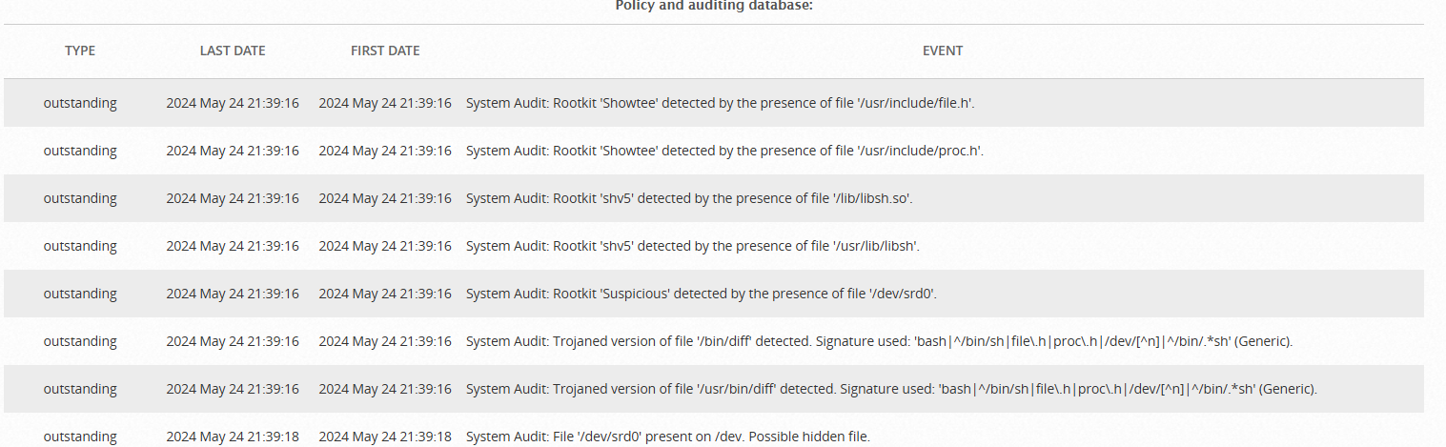
Scenario : Rootkit attack
Fig: Result of Rootcheck in OSSEC

Slide 35
ASSETS MANAGEMENT
Available Link demo 1: Click here!
Description: monitoring all assets with detailed and consolidated dashboard. Including devices status, number of services and critical level. Select asset and view detailed report about that asset.

Slide 36
ASSETS MANAGEMENT
Available Link demo 2: Click here!
Description: Manage the assets, scanning vulnerability of selected assets and update the asset information. Instant scan and schedule scan

Slide 37
ALARM MANAGEMENT
Available Link demo: Click here!
Description: Consolidate and visualize alarm triggered within all devices. Detail report dashboard : category, assets/group, risk level, …

Slide 38
MORE: NIDS, NETFLOW, REPORT & INCIDENT RESPONSE

Slide 39
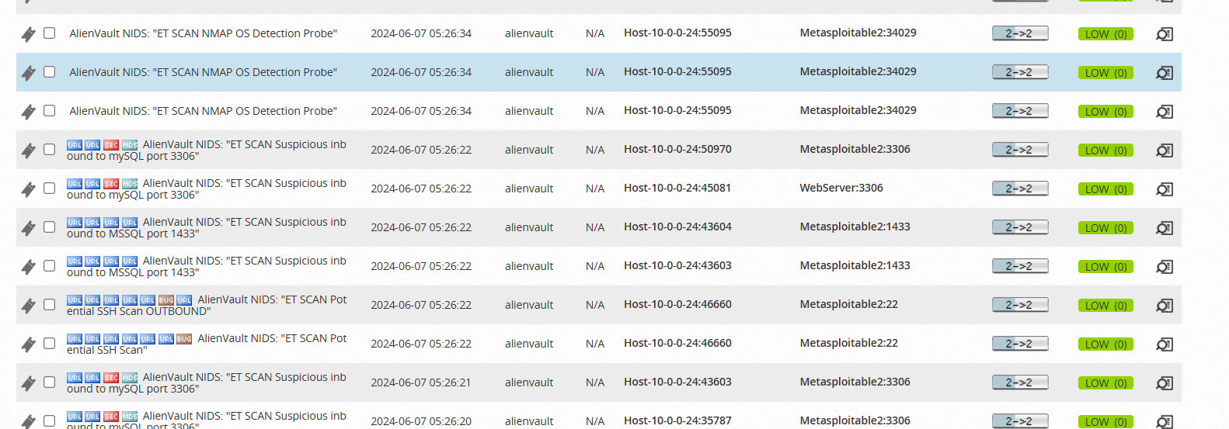
Fig: NIDS’s log

Slide 40
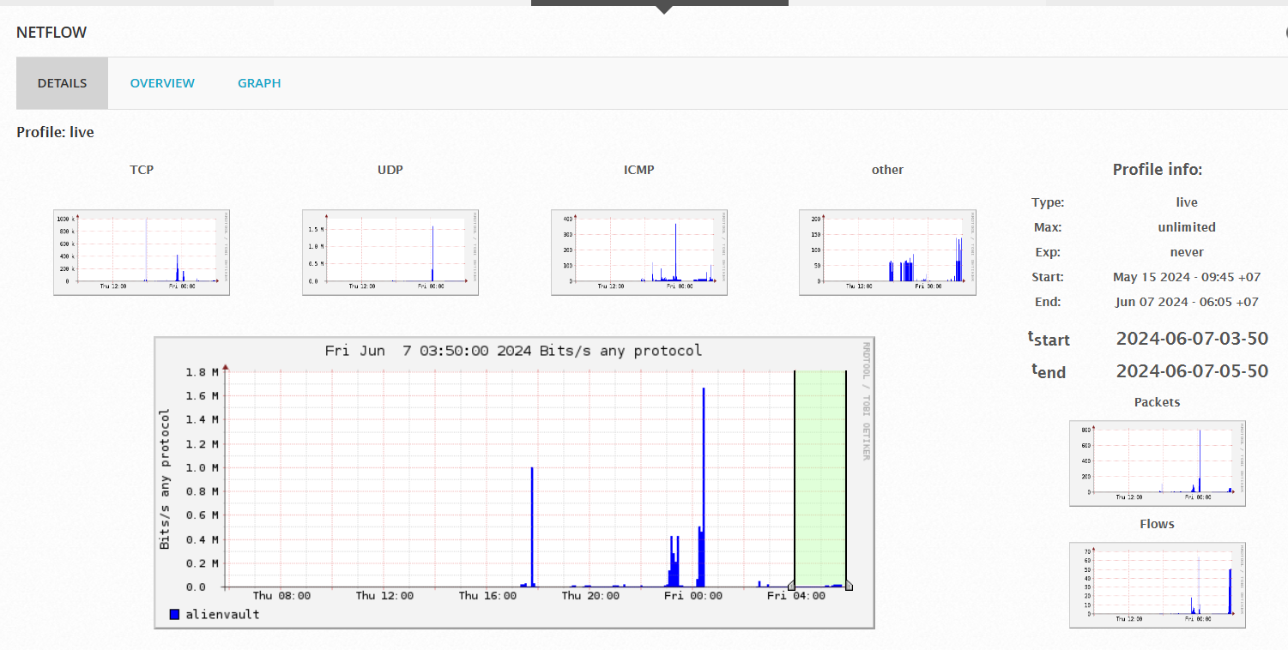
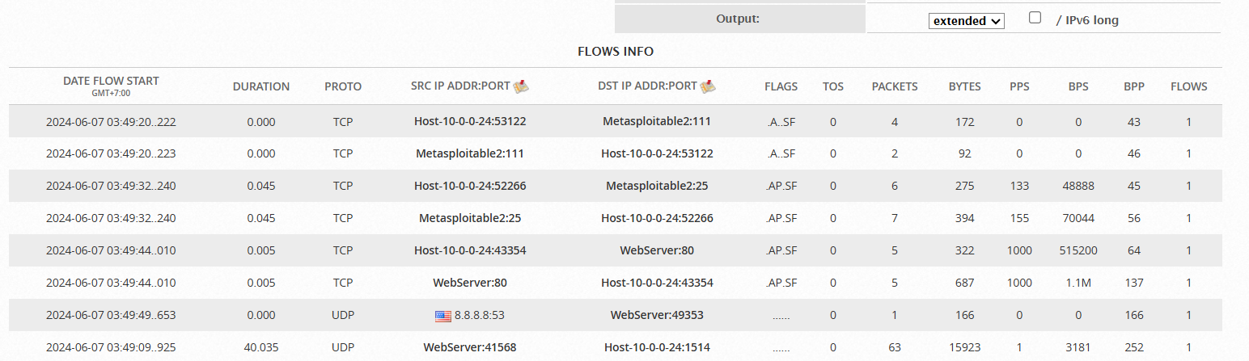
Netflow

Slide 41
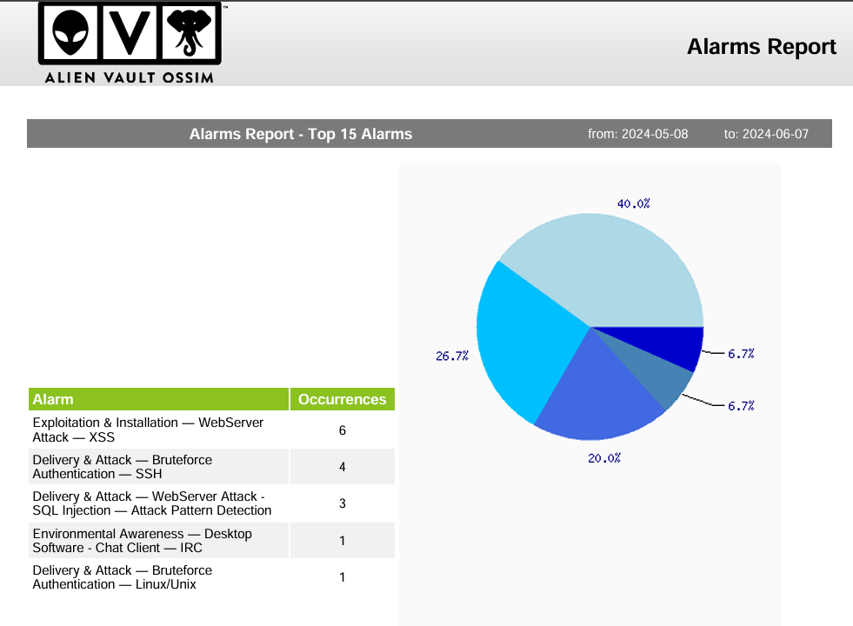
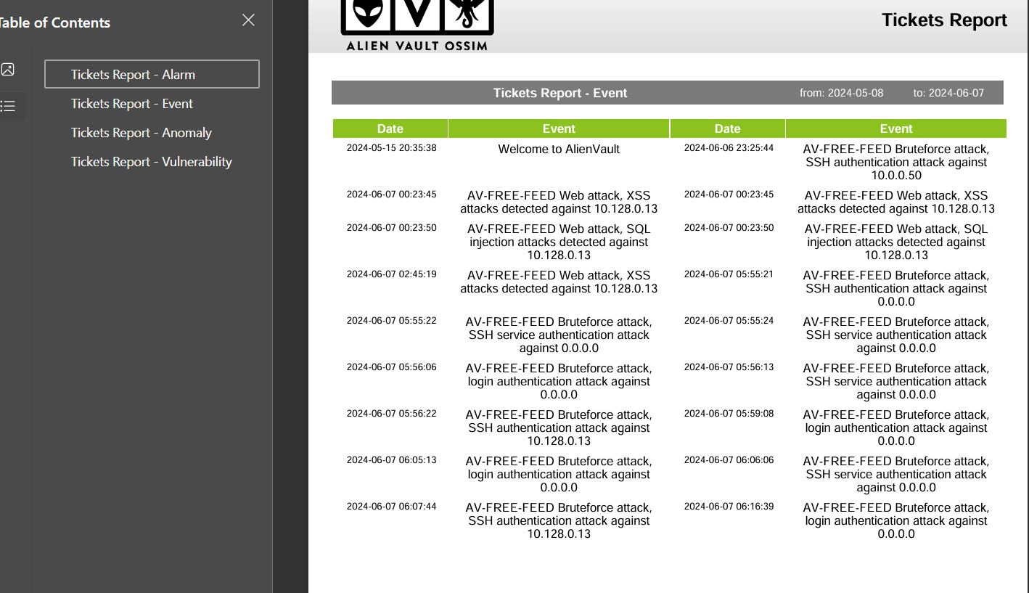
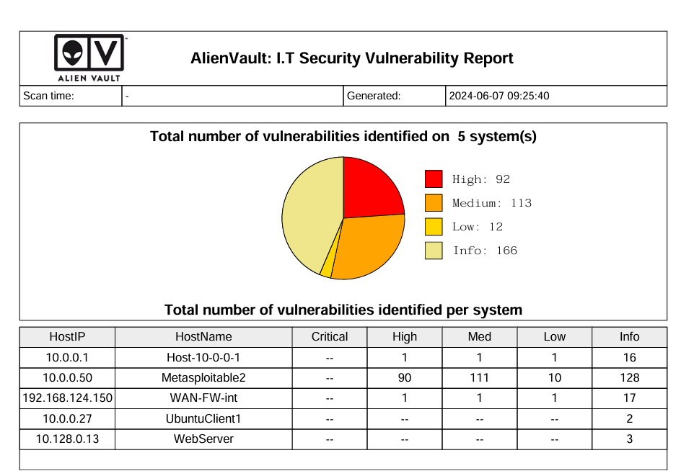
Report Features

Slide 42
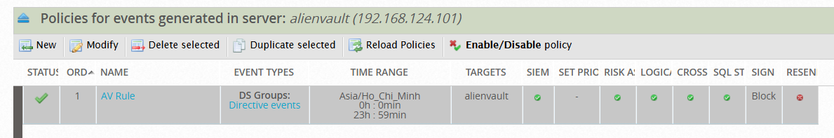
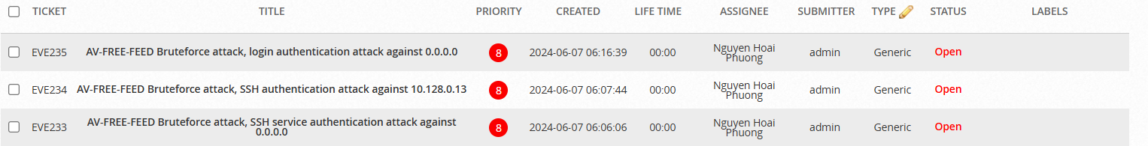
DDoS Attack
Incident Response

Slide 43

THANKS
DO YOU HAVE ANY QUESTIONS?
Contact with Group DA04

